Slide 1
Year 8 Parents’ Information Evening 8t^{h} September 2022
Welcome

Slide 2
Purpose of Meeting
Information
Guidance

Slide 3
Loreto College is a Voluntary Grammar School
We set high expectations in terms of:
Work
Behaviour
Aspirations
Discipline

Slide 4
Personnel
Mr Gallagher - General Information
Mrs Pepin- Challenges in Y8

Slide 5
The School Day
8.50am – 3.15pm
9/10 period day – 30/35 minutes
Split Break - 15 min
Split Lunch - 40 minutes
Extra –curricular activities
Homework
Timetable
2 Week Timetable
7 Form classes & 8 group classes

Slide 6
Y8 Arrangements
Pupils sat a CAT, English Test and Maths Test in June.
Very high achieving Pupils.- We WILL push them
Some students will need additional support in Eng & Maths.- We WILL support them

Slide 7
Y8 Arrangements

Slide 8
Pastoral Care
We aim to educate for wholeness and dignity
Pastoral Care Policy
Child Protection Procedures
Pastoral Care Programme; Learning for Life and Work
Anti-bullying school
DCP - Mrs Mc Carry
DDCP – Mrs Pepin

Slide 9
The Pastoral Care Structure
Principal
Mr S Gallagher
Vice- Principal
Mrs F Pepin
Head of Year 8 – Mr Harkin
Form Teachers in charge of each class
A
B
C
D
E
F
G

Slide 10
Some General Points
Support of parents
- you are first educators
Pupil
Teachers
Parents
The Campaign for Learning found that parental involvement in a child’s education can mean the difference between a top grade and a child who fails to achieve.

Slide 11
Communication
- Parent Teacher Meetings (30 March)
- Reports (January & June)
- Homework Diary - Teacher Comments – please check
Email – primary contact – aim to reduce paper – Parent Pay sign up is essential
- Information on website
Text messages

Slide 12
Communication with us…

Slide 13
Communication with School
Homework Diary (Parent Comment Section)
Phone Call
Face-to-face meetings require appointments to be made in advance.

Slide 14
Year 8 Pastoral Team
Mr E Harkin - Head of Year
8A Mrs Mullan
8B Mrs McCloskey
8C Mrs Loughrey
8D Miss O’Brien
8E Mrs Carey
8F Mr McGoldrick
8G Mrs McBride

Slide 15
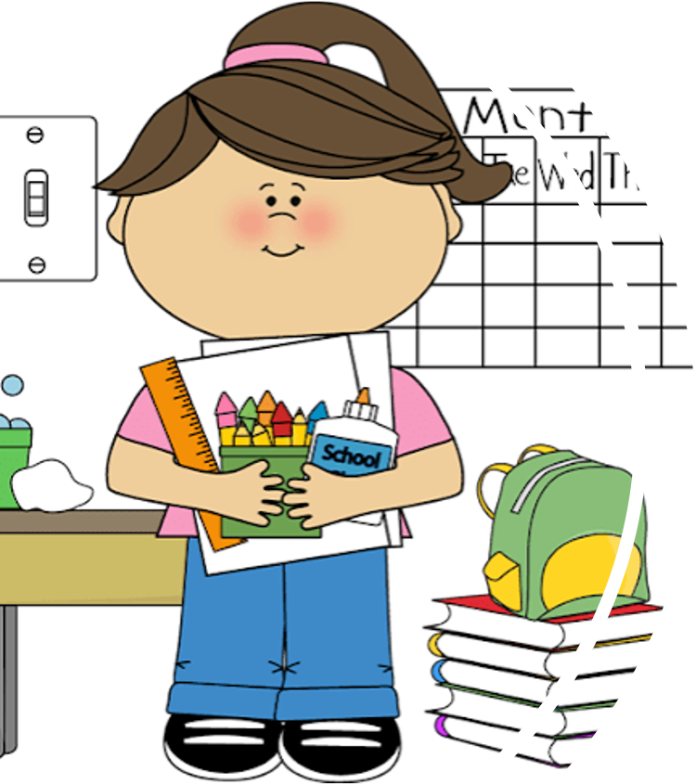
Academic – how can you help?
Get organised
Timetable
Folders
Check homework diary and sign each night
Specific area to study
Pack bag the night before

Slide 16
Timetable

Slide 17
Folders

Slide 19
For Covid absence only
Class codes issued shortly
Check your child has logged on.
Help guide available on our website (information menu)

Slide 20
Academic success requires a disciplined school environment.
Positive approach to behaviour management
Acknowledging what is good and correcting wrong.
Promoting Positive Behaviour
&
School Discipline

Slide 23
Parent / Guardian to contact school if absent (email / phone)
If absent, pupils must bring note the day they return.

Slide 24
Pupils must get temporary absences signed by HOY IN ADVANCE of leaving school.
Pupils must sign in and out at the main office.
Please avoid temporary absences where possible.

Slide 25
Daily registration
Assembly
Settling In booklet

Slide 26
Trained counsellor in school one day per week.
Pupils visit the counsellor for a variety of reasons and issues such as anxiety, coping with an illness in the family, bereavement ……
Valued resource within the school.

Slide 27
Challenges facing Y8 pupils
Organising books
Keeping on top of homework
Completing projects/deadlines
Making friends

Slide 28
Homework club –supervised club with support from senior pupils. Mon –Wednesay 3.15pm to 4.15pm.
Maths Support Club - Tuesdays
My Maths – computer based learning. Excellent resource to use at home.

Slide 29
Learning Support
Students will be scheduled for additional support if required.
Numeracy
Literacy
Organisational skills.

Slide 30
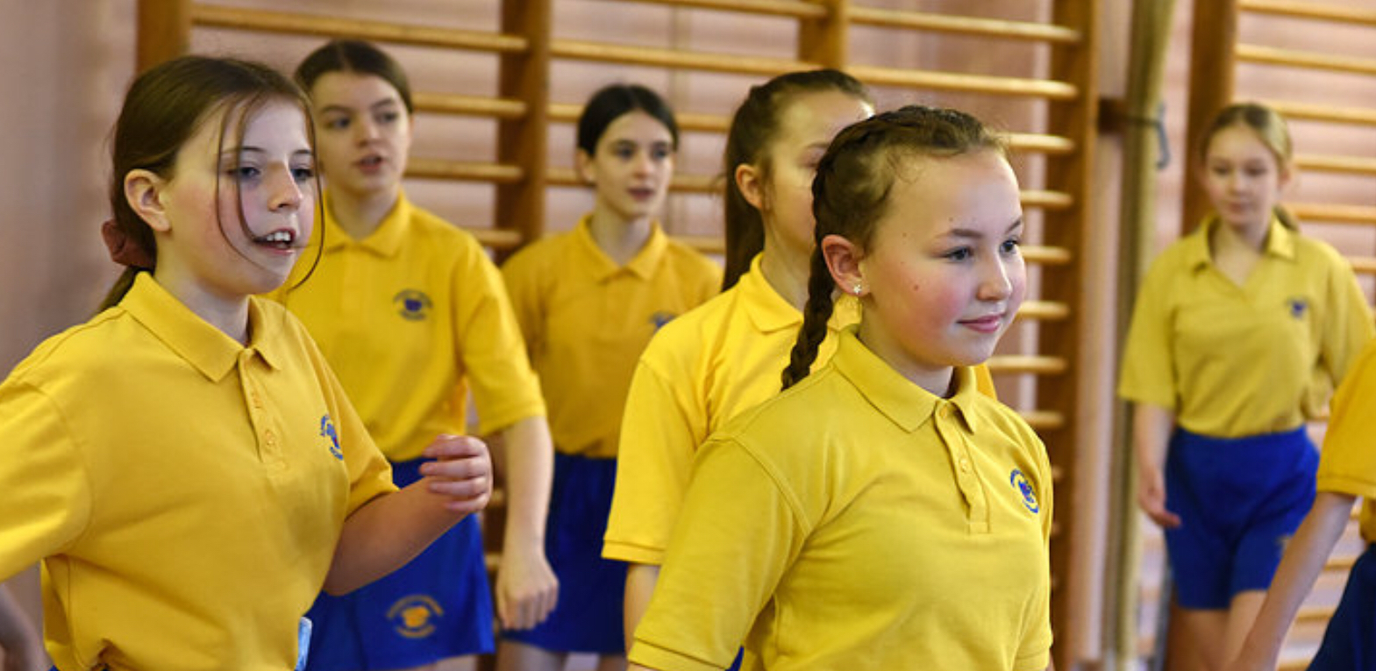
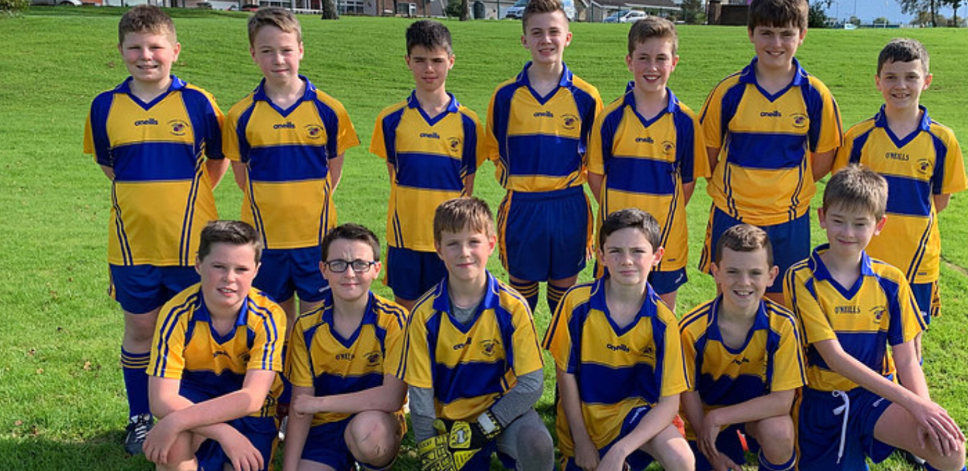
Choir
Netball
Cross country
Soccer
Gaelic games
Drama club
Basketball
And many more

Slide 31
Finally …
Receptive pupils
Attendance
Manners & Respect
Uniform
Develop study habit

Slide 32
Important Dates
PTM – Thursday 30th March
School Musical – Oklahoma – 18th-21st October
Please see calendar on Website

Slide 33
Conclusion
Thank you for your support
Form Teacher Information Slips

