Slide 1

Year 13
Parents’ Information Evening

Slide 2
Structure
Mr Gallagher (Principal) Introduction
Mrs McCarry AS/A level Pathway
Mrs McEwan A Level Study
Mrs Guiney Careers, UCAS Process
Mrs McCarry Student Finance

Slide 3
Transition to ‘A’ Level
A difficult step
Increased content
Degree of difficulty
Independent Study is necessary

Slide 4

Phones/Devices

Slide 5
‘A’ Level Examination Routes
Modular –
CCEA have retained modules, but only available in June.
Linear –
English boards
(OCR, EDEXCEL) have
adopted linear model.

Slide 6
Year 13 AS Exams
June 2026 – sit all units/modules in each subjects (See P.7&8)
13 August 2026– AS results
June 2027 – only opportunity for AS re-sits

Slide 7
Year 14 A2 Exams
June 2027 – sit all modules in all subjects
August 2027 – A2 results

Slide 8
AS and A-level Structure
CCEA Year 13 |  | CCEA Year 14
AS1 | AS grade | Total AS score 40% | Final A-Level Grade
 |  | A2-1 A2-2 60%
AS2

Slide 9
AS and A-level Structure
Year 13 - Edexcel |  | Year 14 – Edexcel
AS1 | AS grade | AS1 & AS2 | A-Level grade
AS2 |  | A2 – 1 & A2 – 2

Slide 10
‘A’ Level Equivalents
IT & Business Studies
Level 3 Vocational qualifications
OCR CTEC (Cambridge Technical)
All portfolio/coursework based
Rigorous & demanding
Accepted by QUB, UU and others

Slide 11
‘A’ Level Equivalents
A-level Grade | OCR Cambridge Technical Introductory Certificate Level 3
A | Distinctions in ALL 6 units
B | 3 Distinctions & 3 Merits
C | Merits in ALL 6 units
QUB will accept ONE vocational qualification AND ONE applied A-Level alongside an exam-based A-level.
University of Ulster will accept up to THREE vocational courses.
Not accepted for Medicine, Dentistry or Pharmacy degree course.

Slide 12
BTEC Structure
Year 13 - BTEC | Year 14 – BTEC
Unit 1 External Assessment | External Assessment
Unit 3 Sports / Unit 5 Construction Internal Assessments | Internal Assessment
Please see Student Handbook for BTEC for further information

Slide 13
How to achieve an A*
Students must meet the following requirements:
  80% UMS overall (i.e. the current requirements for an A).
  90% UMS overall in the A2 units.
Students do not get an A* for 90% overall. Only the A2 units (the units taken in Year 14) count towards the award of an A*.
Can I get A* at AS level?
No, you can only get it at A2.

Slide 14
Importance of ‘AS’ Levels
Platform/gateway for A2
Predicted grades for UCAS
University offers based on AS
Marks generally easier to obtain
4 AS = Choice / safety net

Slide 15
Information Sources
www.qca.org.uk
www.jcq.org.uk
www.ccea.org.uk
www.ocr.org.uk
www.edexcel.org.uk
www.aqa.org.uk

Slide 16

Mrs McEwan
Head of Year 13
A Level Study

Slide 17
Success in Year 13 depends on:
Attitude
Attendance
Punctuality
Consistency of effort
Communication
Support provided in school – page 2 of booklets
Balance – e.g. extra-curricular; PT jobs

Slide 18
Study Skills
Refer to Study Skills booklet – pages 7 and 8 – for listing of examinations.
Ensure three hours (minimum) per night
Provide a quiet environment conducive to effective study; organised; resources
Control of social media - monitor use of PC/mobile phones/gaming etc. at home.
Check homework diary on a regular basis for deadlines etc.
Google Classroom Codes – page 9
Driving lessons – not during class time
Parking permits necessary if bringing a car to school.

Slide 19
Practical Advice for Parents
Encourage Independent study
Support and encouragement – school events - parent’s newsletter; website
Awareness
- subjects
- study habits – not just homework!
- examination times
- module results
Re-marks – be advised – student and parental decision – grades may go up but can also go down! The grade / score awarded after a remark is what will remain on the candidates record.

Slide 20
General points
AS and A2 Units may be repeated. In this case, the higher mark will be awarded.
The College covers all examination fees for a student’s first entry.
Student/parents pay for repeat examinations.
Each module costs £20 -30 approx.
Avoid re-sits for many reasons.
Familiarise with specifications/past papers/ model answers/ examiners’ reports/ examiners’ advice.

Slide 21
Y13 can be a difficult year – pages 4-6 gives guidelines on revision tips and stress management.
We are a Take 5 school! Please encourage young people to have a good balance.

Slide 22
Dates for your diary p3

Slide 23
And finally...
The young person's first and most influential teacher is the parent.
The effectiveness of home as a learning environment is critical to promoting long-term school success.

Slide 24
nit 1 Construction Principles is External Assessment, worth 30% of overall award. Unit 5 Health and Safety is Internal Assessment and worth 20% of overall award. Together 50% of overall award.
Mrs S Guiney
Head of Careers
Careers Education, Information, Advice and Guidance
(CEIAG)

Slide 25
Pathways after A Level
Higher Level Apprenticeships
University/College
Foundation Degree
Higher National Certificate/Diploma
Employment
Gap Year

Slide 26













Years 13 & 14 overview
Careers once a fortnight.
Staff facilitate and offer guidance:
Mrs West Careers Coordinator
Mr Byrne
Mrs Guiney
Information and opportunities through:
Google Classroom Year 13 h3ukuvk
Email c2k
Futures For All
Unifrog
Parents' Newsletter/text/email
Drop-in lunchtime once a week
Careers Advisor
Trial Interviews October (Year 14)
Student Finance (Year 14)
Plans A-C (Year 14)

Slide 27
Year 13 – Career fortnight
Year 13
Year 13
Starts 8th June:
Presentations from QUB; UU; CAFRE; ATU inc CAO process; Dpt of Economy and Work plus
Work experience – process:
From 11th – 19th June
Find an employer(s)
Details and indemnity forms through Mrs West
Commence UCAS registration process.
Summer Schools - UU, Queens, Oxford, Employers offering Apprenticeships. Utilise organisation websites and social media – Facebook, Instagram, Twitter and TikTok.
Early applicants' deadline mid-October 2026 need to inform Careers Dept in Year 13.
Open Days June Year 13 and Autumn Year 14.
QUB Saturday and UU proposing the same.
Grades and changes in entry requirements for some courses.

Slide 28
University and College Admissions Service:UCAS process:
Applicants have up to five choices initially.
Choices are automatically arranged in alphabetical order not in order of preference.
If applying for medicine, dentistry or veterinary four of the five choices must be for these courses.
Once all offers have been received, the five choices are reduced to two – a firm and an insurance choice.
Timelines and deadlines will be available from UCAS at the start of each academic year.
St Mary’s University Belfast is not part of UCAS. A separate application is required.
Apprenticeships separate and January of Year 14 and Results Day are the two main launches.
Secure web-based system- ‘ucasapply’
Easy and convenient.
Prevents simple errors.
Speeds up the processing of applications.
Current Fee £28.95
Acts as intermediary between applicants and universities.
Fair for all.
Deadline for Firm and Insurance choices to be made by beginning of June Year 14.

Slide 29
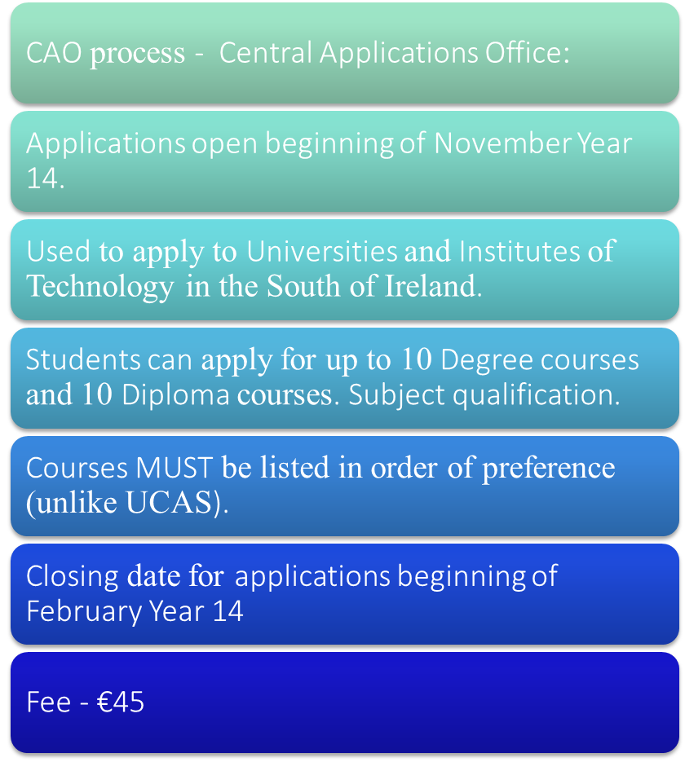
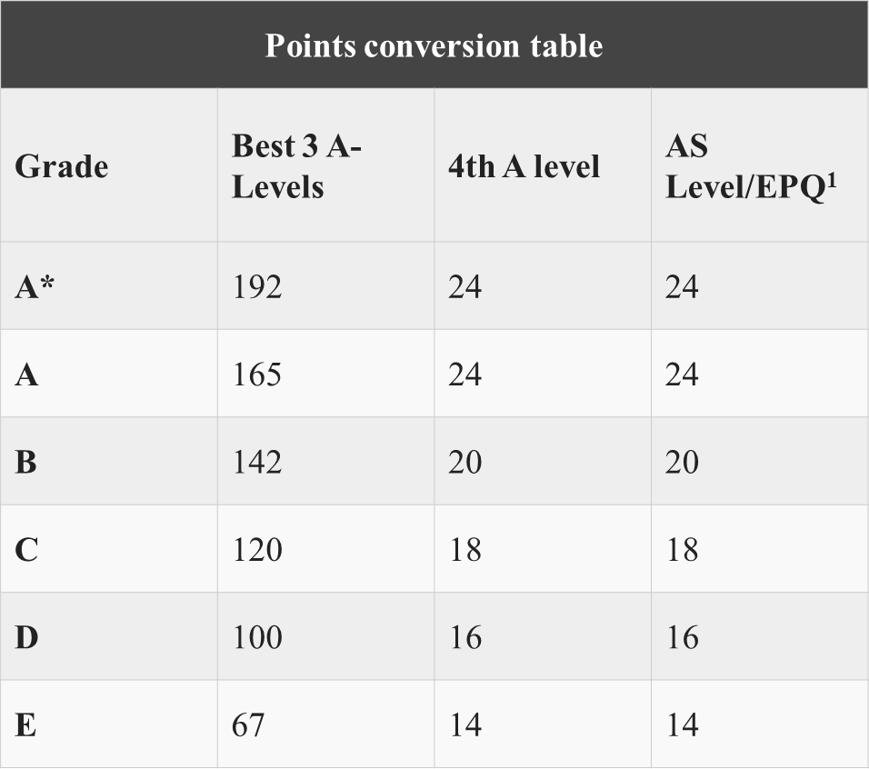
Central Applications Office (cao.ie)

Slide 30
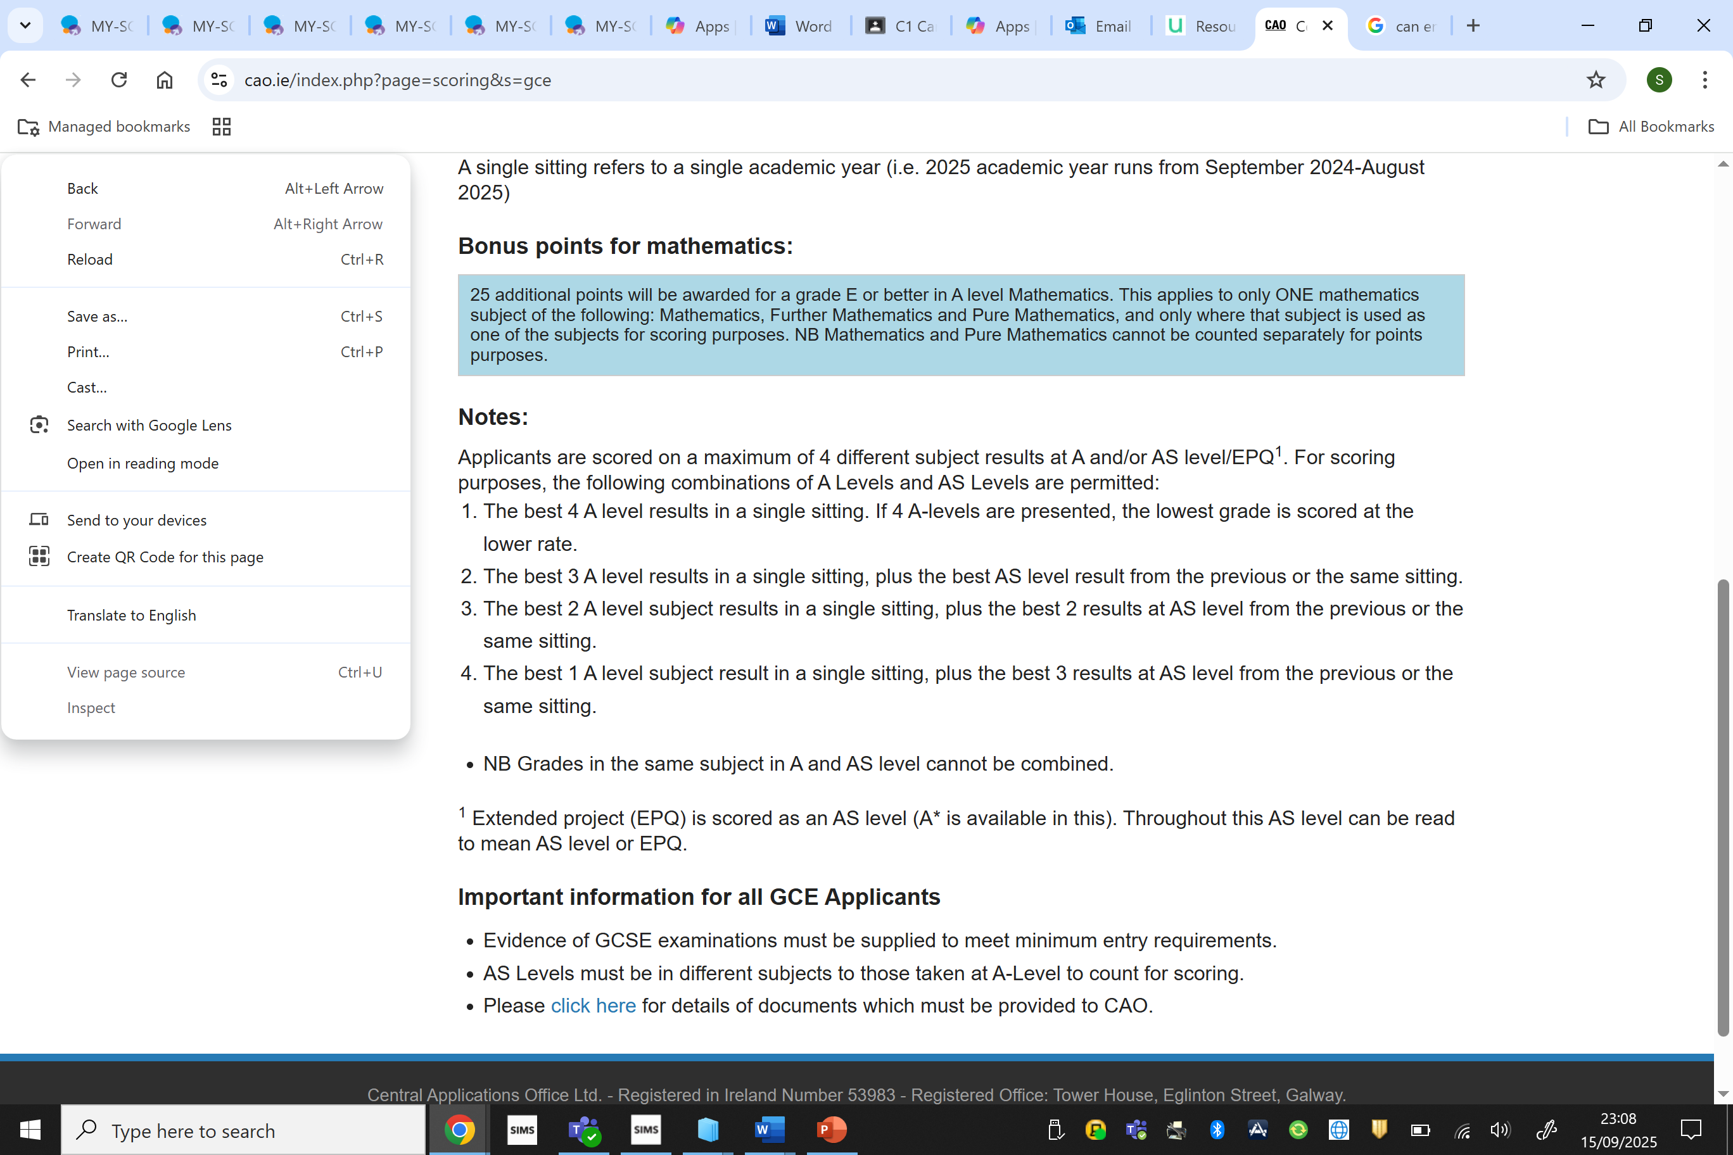

Slide 31
USEFUL WEBSITES
Ucas.com - parent guidance available.
cao.ie
studentroom.com
studentfinanceni.co.uk
completeuniversityguide.co.uk
opendays.com
esu.org/our-work/secondary-school-exchange
eunicas.co.uk
qub.ac.uk
Ulster.ac.uk
Workplus.com
Causeway Apprentices.com

Slide 32

Higher Education – Finance
Mrs S. McCarry

Slide 33
University?
Advantages
Disadvantages
Job prospects
Opportunity to meet professionals
Transferrable skills
Socialising
Life skills – independence
Further study into an area of interest
Cost
Not always guaranteed a job
Might change your mind
Could slow career progression
Stress – one in four students may experience mental health issues

Slide 34
University or not?
Yes - IF you think it's the right decision for you!
If the dream job doesn't require a degree, then
perhaps university isn't the right route. Learn through
experience:
Vocational Courses
Apprenticeships
Recruitment programs may run in some companies – e.g. internships.
Similarly, struggling with making the leap to
independent living and learning, might suggest
university is not the path to go – just yet! Take time!
Gap year.

Slide 35

A Degree Costs a lot of Money
Is it worth it?

Slide 36
… Usually!
Graduates are more likely to be in continuous employment and earn more than non-graduates.
Research shows that investing in a degree is usually a good investment
- even on purely financial grounds.
“An investment in knowledge pays the best interest.” – Benjamin Franklin

Slide 37
New analysis shows students who choose to learn more, earn more
Last updated on Tuesday 4 Mar 2025
“A university education continues to pay dividends, throughout an individual’s career. With exceptionally positive outcomes for students from less advantaged backgrounds, it is clear universities do provide an essential opportunity for individuals to reach their potential wherever you are in the country. We continue to call for an uplift in maintenance support, including grants for those who need them the most.
Vivienne Stern MBE
Chief Executive, Universities UK

Slide 38
Graduates overtake those who chose not to go university within just a few years, earning at least 20% more once they are in their mid-20s. By age 31, graduates typically earn 37% more.
Graduate earnings increase at a faster rate than those of non graduates. Between the ages of 23 and 31 average earnings grow by 72% for graduates compared to 31% for non graduates.
Graduates aged over thirty are more likely to be in work, and far less likely to be claiming benefits, than those without a degree.
Universities UK 2024

Slide 39



The cost of university falls broadly into two categories:
Tuition Fees
Living costs (Maintenance)
Notes:
39

Slide 40

Tuition Fees
Country of residence | Studying in Northern Ireland | Studying in England | Studying in Scotland | Studying in Wales | Studying in Republic of Ireland (ROI)
Northern Ireland | £4710 | up to £9,250 | up to £9,250 | up to £9,250 | €3,000*
*Tuition fees are not charged in the ROI.
All students pay a contribution charge. For the academic year this is €3,000 (students will receive sterling value of £2,587.80).
Notes:
40

Slide 41
Living Costs
Travel Costs
Books / ICT
Entertainment
Clothes
Food
Accommodation
Notes:
41

Slide 42


Average student monthly costs...
Groceries £101
Going out £47
Takeaways and eating out £41
Transport £34
Clothes and shopping £34
Other £18
Course materials £17
Mobile phone £15
Health and wellbeing £15
Holidays and events £14
Gifts and charity £13
TOTAL £349 x 8 (months) = £2792

Slide 43

Belfast Halls of Residence
Ensuite Room in a shared
Apartment – communal space for kitchen and living room – 6 apartments
En Suite Bathroom / Bedroom
2025 PRICE
From £152/Week x 44
week contract = £6688
NI Tuition Fees: £4855

Slide 44

NI Costs
Accomodation: £6688
Tuition Fees: £4855
Costs: £2792
Annual Expenses £14335
X3 = £43005
NB Tuition Fees for England. Scotland and Wales - £9535

Slide 45

What support is available?
  Government Funding
    Maintenance Grant for living costs
    (NON-REPAYABLE)
    Special Support Grant (NON-REPAYABLE)
    Student loans for tuition fees and living costs (REPAYABLE)
  University
    Bursaries (NON-REPAYABLE)
    Scholarships (NON-REPAYABLE)
    Hardship funding (NON-REPAYABLE)
  Part-time Work
  Help from Family

Slide 46
Maintenance Grant
Non-repayable grant for students from lower income households.
Helps with everyday costs like food, travel or accommodation.
Worth up to £3,475 a year – depending on household income.
If your household income falls between £19,203 and £41,065 you may be eligible to receive a partial grant, depending on the level of your household income.
Notes:
46

Slide 47
Special Support Grant
A Special Support Grant is available to students who have an underlying eligibility to Income Support or Housing Executive Benefits (e.g. if you have a disability or a child) (Also £3,475)
If your household income is more than £41,065 you will not be eligible to receive a Maintenance Grant or Special Support Grant.

Slide 48
Student Loans
The Maintenance Loan is a Student Loan provided by the government, and it's intended to help towards your living costs while attending university...rent, bills, food...
You apply for the Maintenance Loan through the same process as Tuition Fee Loans and, eventually, you'll make repayments on the two as a joint sum.
Students from England, Northern Ireland or Wales can all apply for a Maintenance Loan online or by post.
However, the Maintenance Loan and the Tuition Fee Loan are technically two separate types of funding.

Slide 49
Maintenance Loans
All eligible full-time students can get a Maintenance
Loan, but the exact amount you can borrow will
depend on several factors, including
your household income,
where you live while you’re studying and
whether you’re in the final year of your course.
It’s also affected by any help you get through the Maintenance Grant.

Slide 50
Maintenance Loan
You can take out around 75 per cent of the maximum Maintenance Loan regardless of your household income - this is called the 'non income assessed' part of the loan.
Whether you get the remaining 25 per cent - the 'income assessed' part of the loan - depends on your household income.

Slide 51
Maintenance Loans are paid straight into your student bank account in three (almost) equal instalments throughout the year.
Tuition Fee Loans are paid straight to your university.

Slide 52
Student Loans for Tuition Fees
The majority of students take out a Student Loan for their total fees
Paid directly to the college or university by
The Student Loan Company
No income assessment involved
Notes:
52

Slide 53
Repaying Student Loans
No matter where you’re from in the UK, you only start repaying your Maintenance Loan from the April after you’ve graduated. And even then you’ll need to be earning over the repayment threshold for your type of loan.
The current repayment thresholds for UK graduates are:
Students from England and Wales – £27,295 a year (£2,274 a month or £524 a week) before tax
Students from Northern Ireland – £20,195 (£1,682 a month, £388 a week) before tax
Students from Scotland – £25,375 (£2,114 a month, £487 a week) before tax.

Slide 54
Repayment of Loans
Income (pre tax) | Monthly Salary | Monthly Repayment
Up to £18,330 | £1,527 | £0
£21,000 | £1,750 | £20
£24,000 | £2,000 | £42
£27,000 | £2,250 | £65
£30,000 | £2,500 | £87
Notes:
54

Slide 55
Useful Websites
www.studentfinanceni.co.uk www.ucas.ac.uk
www.studentfinance-yourfuture.direct.gov.uk
www.moneysavingexpert.com
www.student-support.co.uk
www.neelb.org.uk
www.slc.co.uk
www.delni.gov.uk
www.bbc.co.uk/education

Slide 56
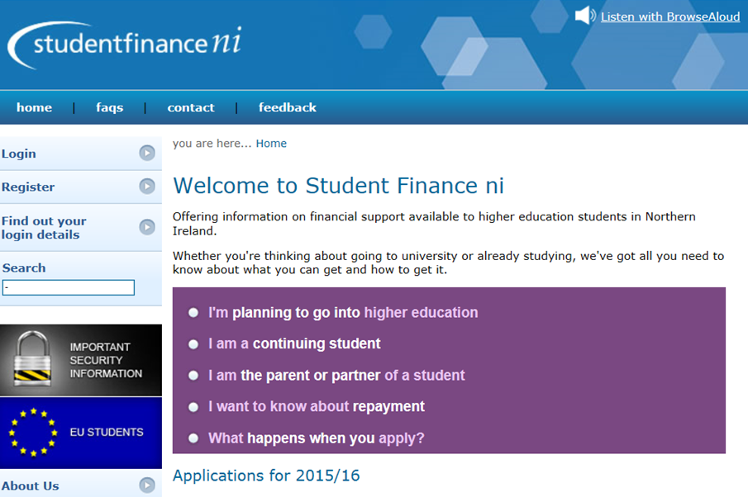
Useful Websites
www.studentfinanceni.co.uk
Notes:
56

