Slide 1

Year 8 Parents Information Evening
4th September 2025
Welcome

Slide 2
Purpose of Meeting
Welcome / School Day/Communication
Mr Gallagher
Pastoral Team / Top Tips for Support
Mrs Pepin
Overcoming challenges /Extra-Curricular
Mrs McAtamney

Slide 3
Loreto College is a Voluntary Grammar School
We set high expectations in terms of:
Work
Behaviour
Aspirations
We encourage all our students to do their BEST and to be the BEST they can be.

Slide 4
The School Day
8.50am – 3.15pm
9/10 period day – 30/35 minutes each
Break – 15 minutes
Lunch - 40 minutes
Extra –curricular activities
Homework
Timetable
2 Week Timetable
7 Form classes & 8 group classes

Slide 5
Year 8 Arrangements
Your children completed CAT Test, English Test and Maths Test in June.
They are very high achieving pupils.
We will stretch and challenge
Some students may need additional support.
We will support them the best we can.

Slide 6
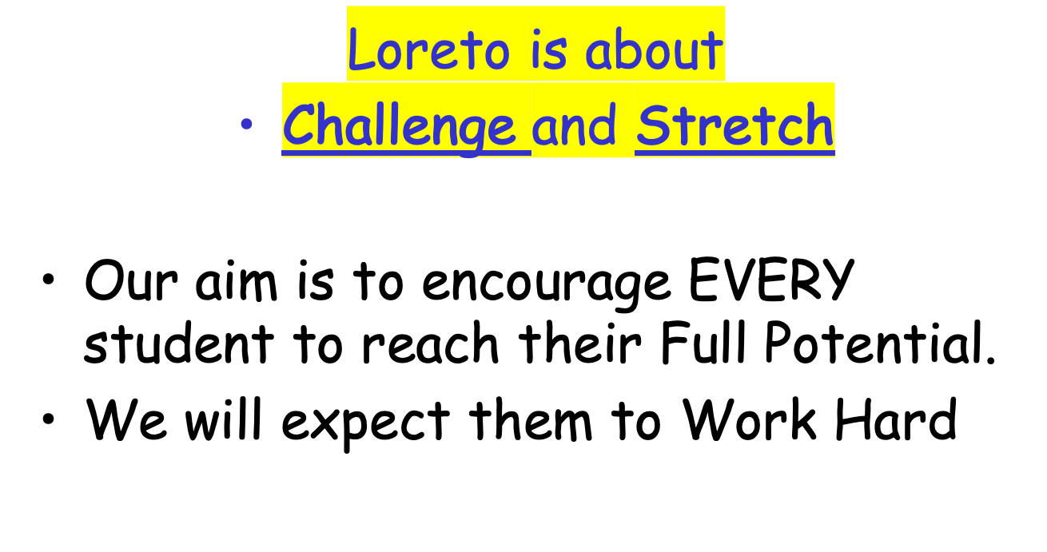
Year 8 Arrangements

Slide 7
Pastoral Care
We aim to educate for wholeness and dignity
Pastoral Care Policy
Child Protection Procedures
Pastoral Care Programme
‘Settling In to Year 8’
Take 5 School
Eco School
DCP – Mrs McEwan
DDCP – Bean Uí Uiginn

Slide 8
The Pastoral Care Structure
Principal
Mr S Gallagher
Vice Principal
Mrs F Pepin
Head of Year 8 – Mrs McAtamney
Form Teachers in charge of each class
A
Mr Bradley
B
Mr O’Kane
C
Mrs Lowery
D
Mrs Carey
E
Mrs McBride
F
Mr Strange
G
Mrs Niblock

Slide 9
Some General Points
Support of parents
you are first educators
Pupil
Teachers
Parents
The Campaign for Learning found that parental involvement in a child’s education can make all the difference.

Slide 10
Communication with you…
Parent Teacher Meetings (20th March)
Reports (January & June)
Homework Diary - Teacher
Comments – please check and sign

Slide 11
Communication with you…
Email primary contact
Parent Pay sign up is essential
Website
Text message
Parents’ Weekly Newsletter
please access via link on texteach week.

Slide 12
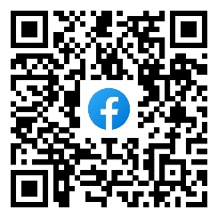
Facebook

Slide 13
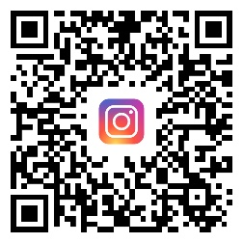
Instragram

Slide 14
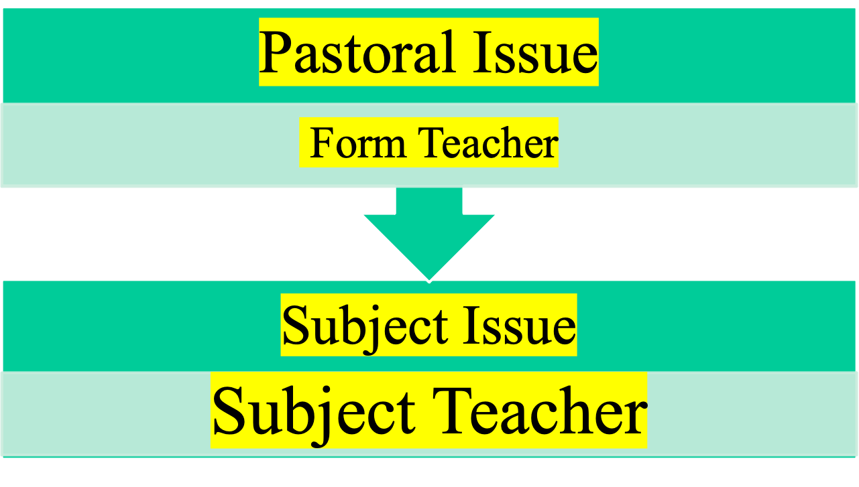
Communication with us…

Slide 15
Communication with us…
Homework Diary (Parent Comment Section)
Phone Call to form teacher / subject teacher
Face-to-face meetings require appointments to be made in advance.

Slide 16

Year 8 Pastoral Team
Mrs N McAtamney - Head of Year
8A Mr Bradley
8B Mr O’Kane
8C Mrs Lowery
8D Mrs Carey
8E Mrs McBride
8F Mr Strange
8G Mrs Niblock

Slide 17

How can you help?
Organisation
Timetable – display
Folders
Check homework diary and sign
Specific area to study
Pack bag the night before

Slide 18
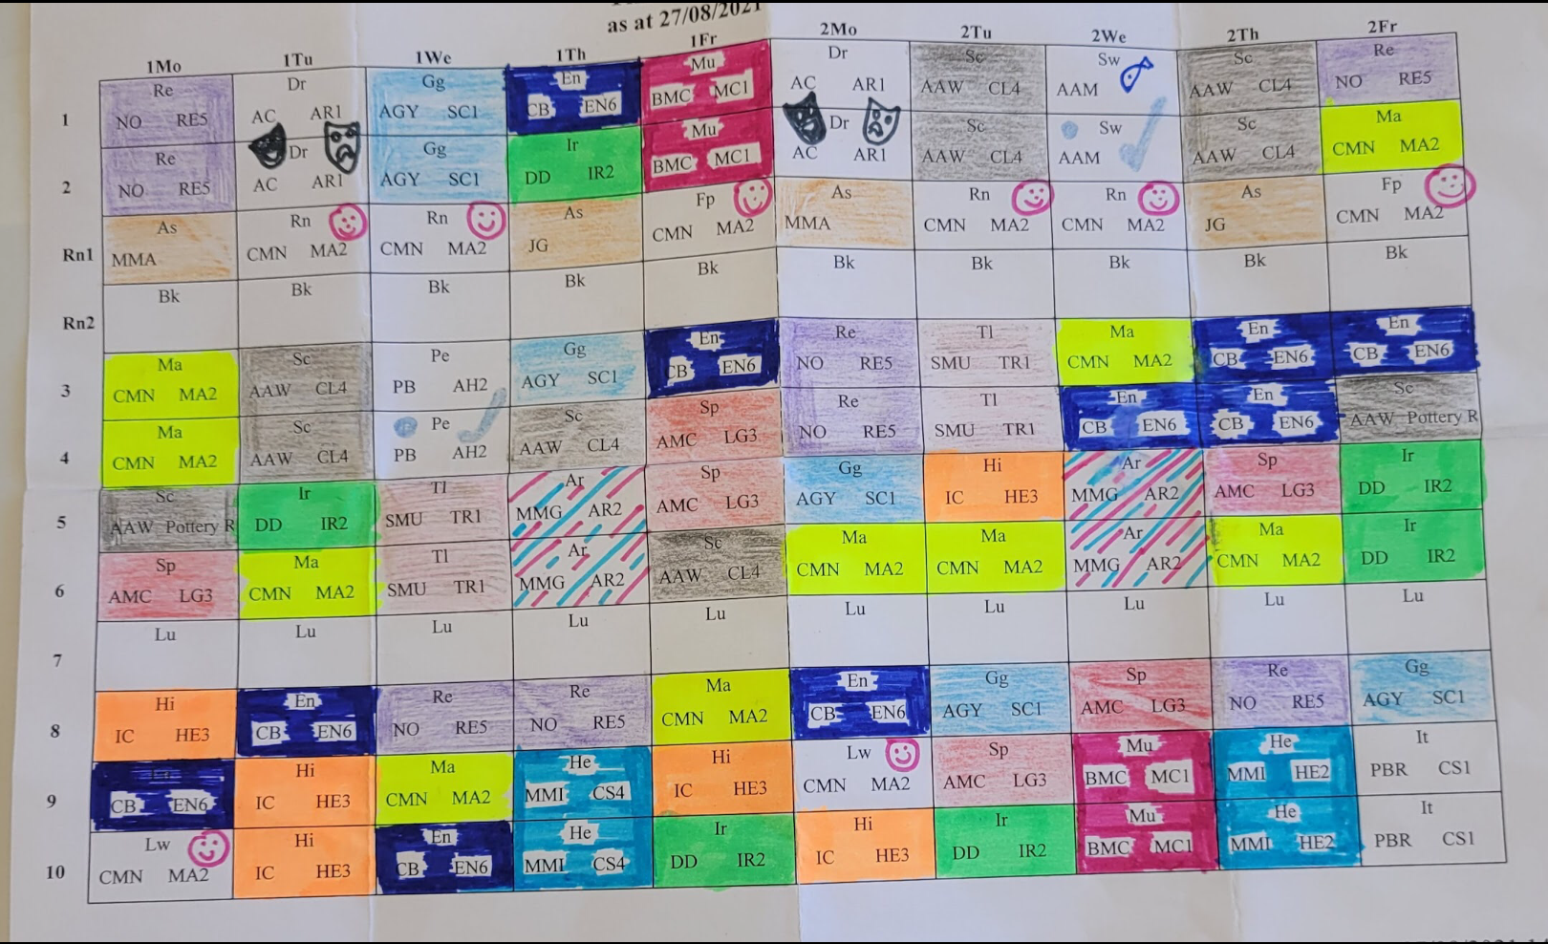
Timetable
Notes:
Two week timetable. Most periods 35 mins, some 40. Split lunch. It can take time to get used to the two week cycle.

Slide 19
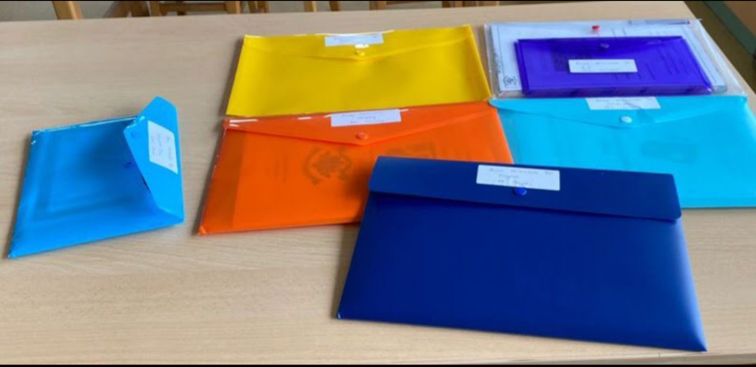
Folders
Notes:
Some top tips for organisation include different coloured photos and labels. It can come more naturally to others. Please help them pack their bags at the start ad then encourage independence. Please encourage not taking all the books and folders each night.

Slide 20
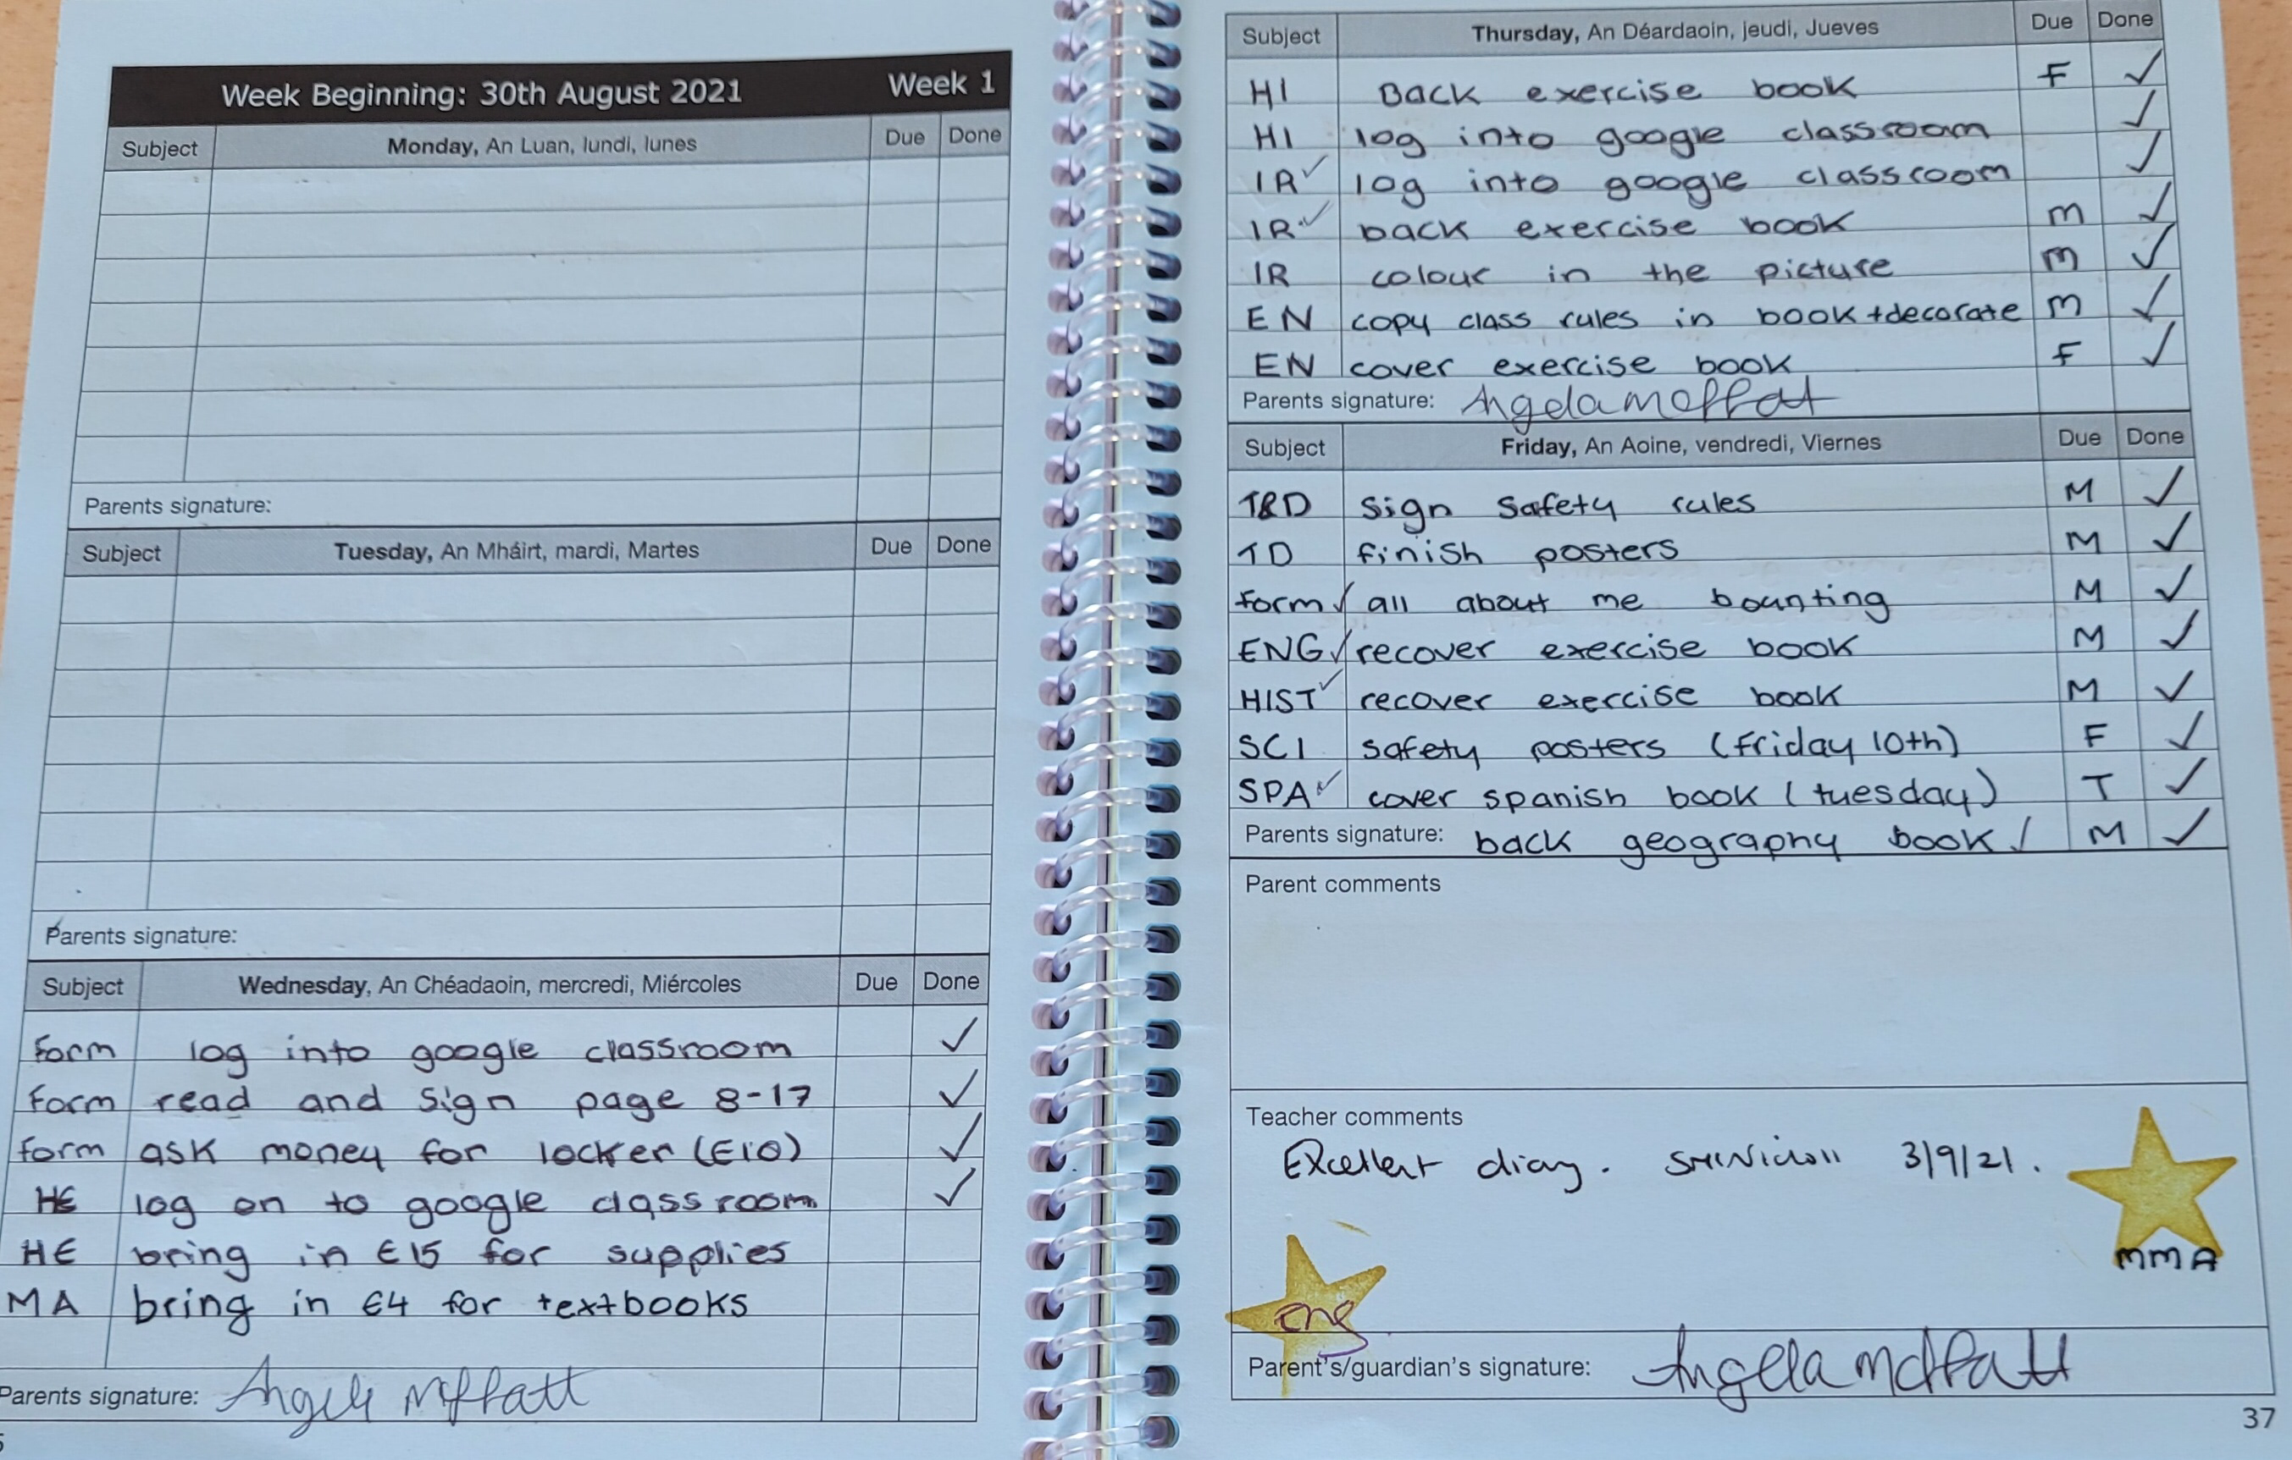
Notes:
This is such an important book. The pages are dated and tell students what week it is. There is also a comments section. Please look over diaries each nigt and sign weekly.

Slide 21




Class codes issued
Check your child has logged on.
Help guide available on our website (information menu)
Notes:
All students will be given Google Classroom codes. This technology can be really useful. They will learn about how to use it in ICT class.

Slide 22

Promoting Positive Behaviour
Academic success requires an engaging school environment.
Positive approach
We will acknowledge what is going well and provide guidance if things go off track.
Notes:
One of the many reasons parents cite for sending their children to Loreto is the high standards of behaviour in our school. We set very high standards and expect complaint behaviour from all because it creates the ideal conditions for students to thrive and be part of a positive learning environment. Sometimes they don’t get it right and we do use a range of consequences to support our rules and regulations.
Sometimes if students break the rule, they will be given an after school detention which will mean them having to stay after school to complete some work for one hour. This is fully supervised and you will always be informed about it at least 24 hours in advance.
We also use other consequences such as lunchtime detentions, post incident reflection learning, monitoring cards. This is graduated system and you can read more about it in your child’s homework diary. We will always try to work with them and encourage truth and sincerity in our dealings with them.

Slide 23


Notes:
Some rules that surprise students when we point them out.
With mobile phones, we understand we cannot police this. You are the custodian of your child’s phone. Please monitor for groups chats and use of social media. We cannot monitor this. If phones are seen or used in school they are kept overnight until a parent can collect.
No chewing gum. After school detention.

Slide 24

No Energy Drinks
Notes:
For obvious reason. We have just installed free hydration stations at two key areas in the school and would encourage your child to bring a reusable drinking bottle to school. WE confiscate energy drinks. PARKING.

Slide 25

If a student is unwell during the school day:
They must tell a member of staff
A member of staff will assess
Make a decision about contacting home/ trying to remain in school
Notes:
This is a vital health and safety procedure. Ms Reed is our Daily Pupil Welfare Staff member. If your child is unwell, please don’t send them to school. Please contact school via the contact us page, (revising details and follow up with a complete absence slip (diary).

Slide 26
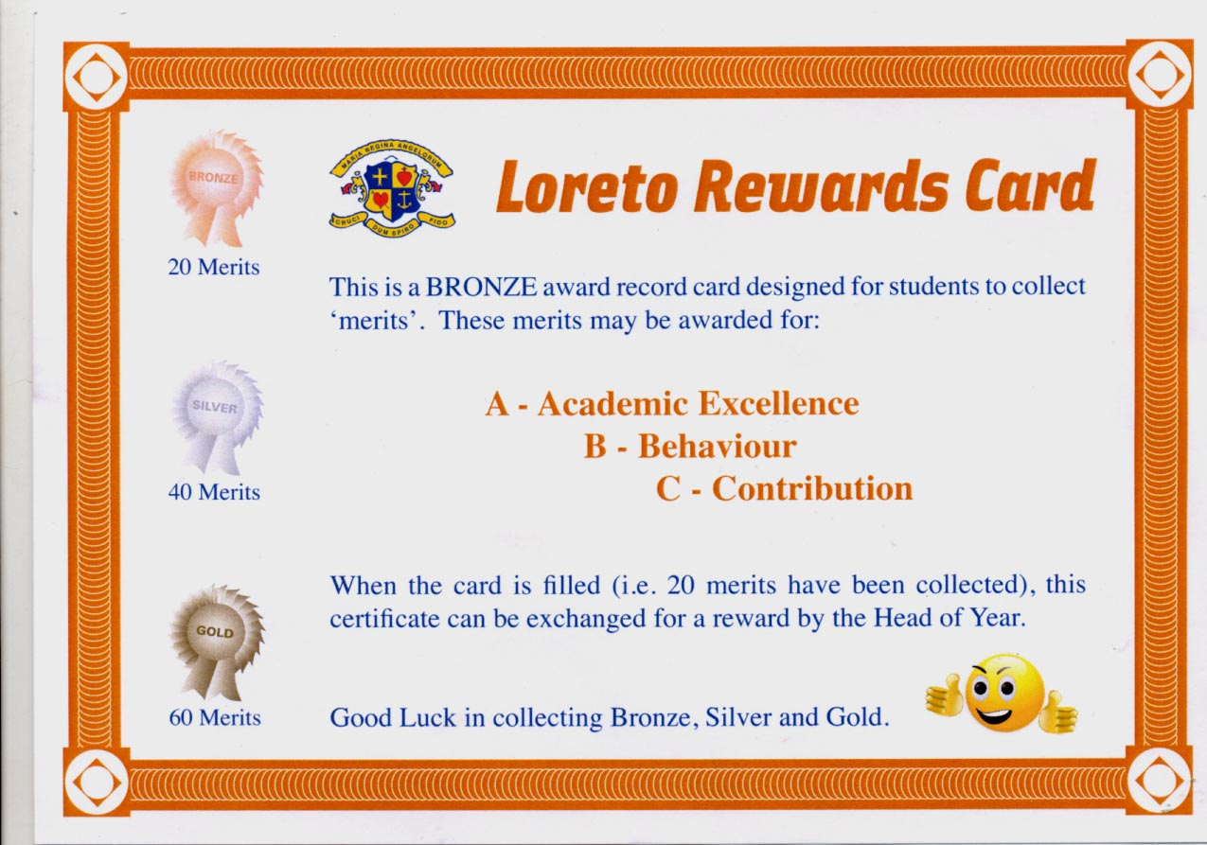

Slide 27

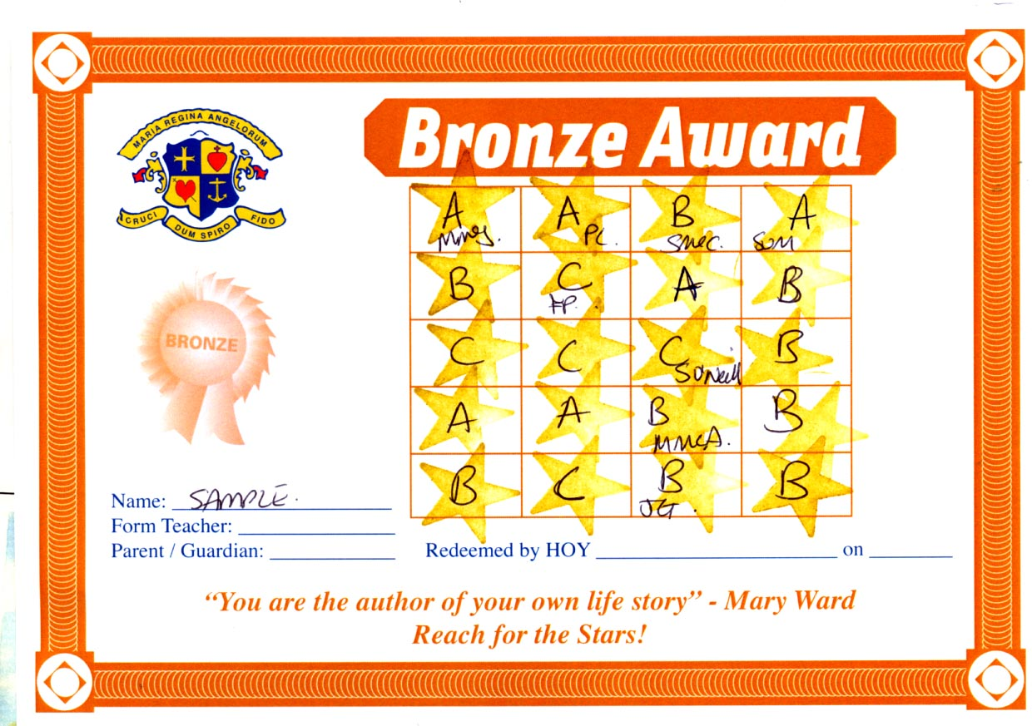

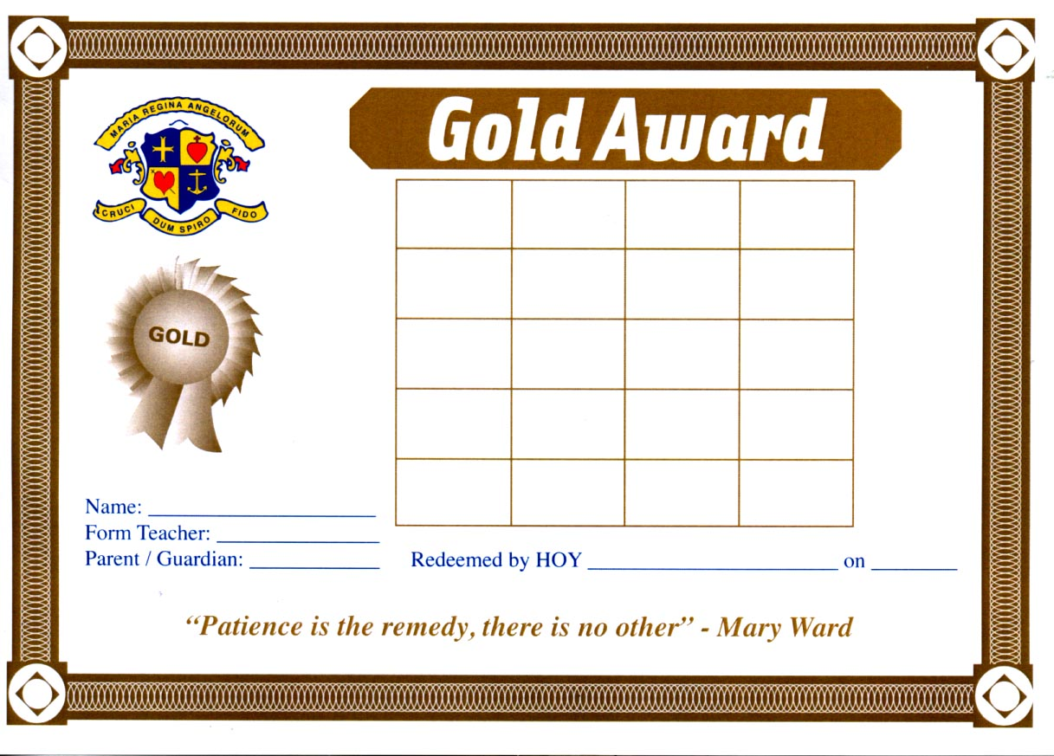



Slide 28
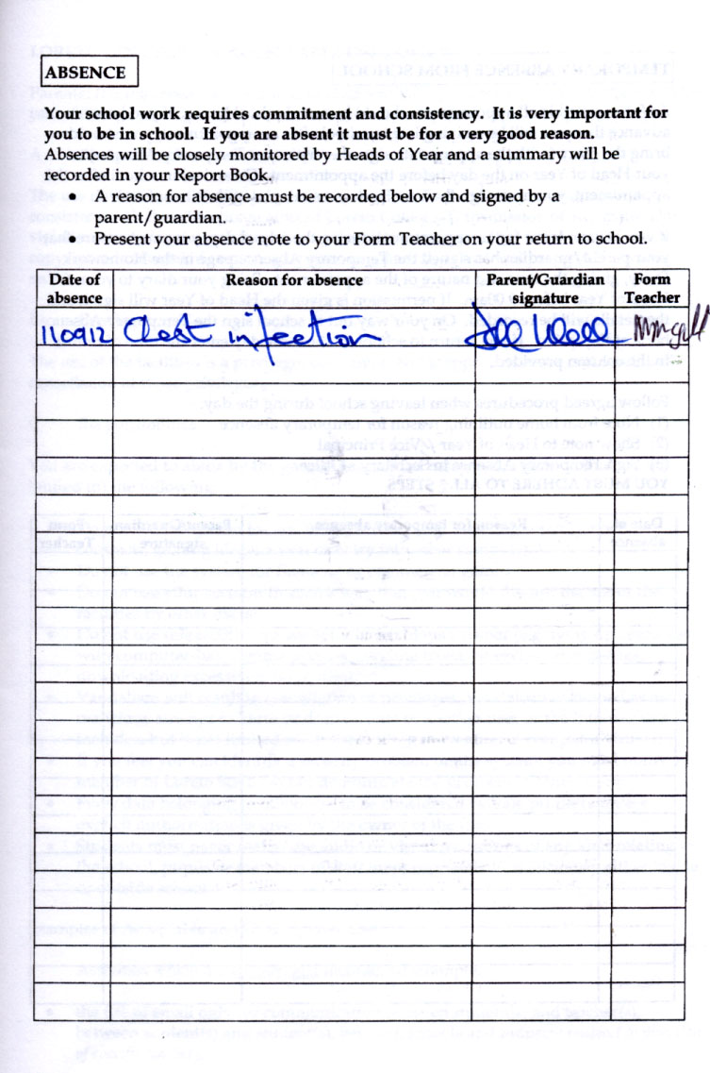

Parent / Guardian to contact school via Contact Us page on website.
Pupils must bring absence notes the day they return.
This should be posted in box in foyer. Otherwise school must chase for unexplained absences.

Slide 29

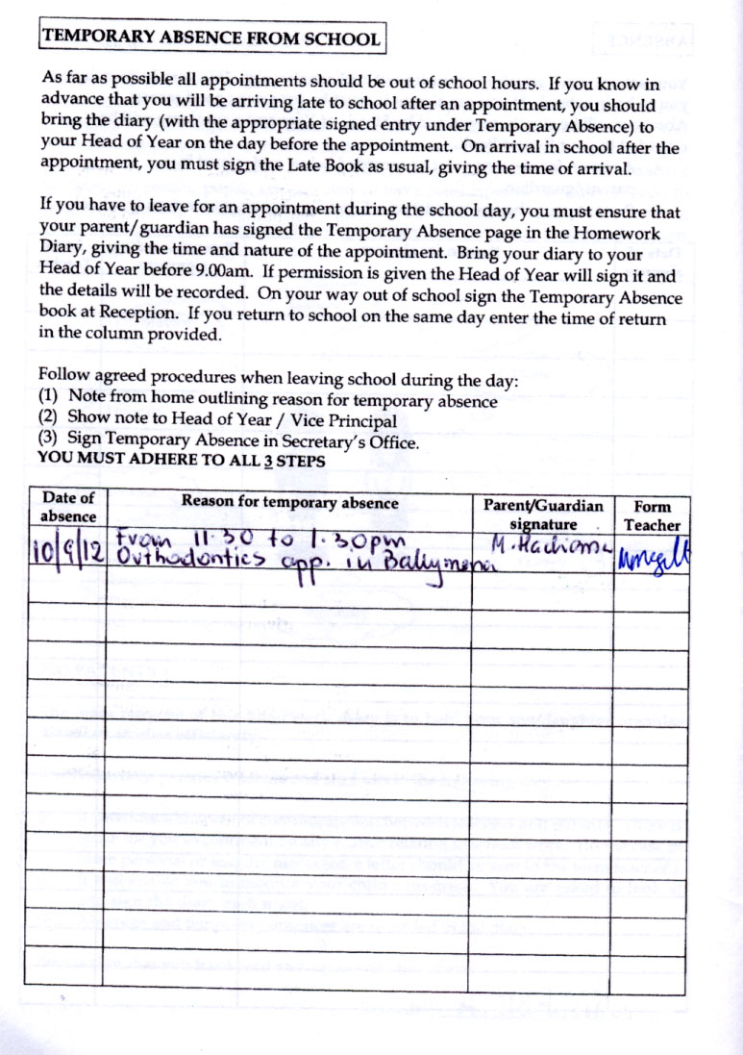
Please avoid temporary absences where possible.
Pupils must get temporary absences signed by HoY in advance of leaving school.
Pupils must sign in and out at the main office.

Slide 30


Daily registration
Assembly
Pastoral programme
Notes:
Key pastoral contacts each day, week and throughout the year.

Slide 31

Take 5 School
Trained counsellor in school each week.
Pupils visit the counsellor for a variety of reasons and issues such as anxiety, coping with an illness in the family or bereavement.
Notes:
Wellbeing is very important to us. We are a Take 5 Platinum Award winning school. Can self-refer or ask to see a counsellor.

Slide 32

Challenges facing Y8 pupils
Challenges facing y8’s
Organising books
Keeping on top of homework
Completing projects/meeting deadlines
Making friends
Notes:
Starting at a new school can feel daunting, especially when it comes to new classes, teachers, homework and friends.
Whilst you, as their parents are their number one support, we are encouraging some independence too– helping them take ownership of their learning and personal development both in their learning and organisation.
This is a crucial stage where they begin to take more responsibility for themselves, and we want to guide them in doing so with confidence.
Organisation is key*** -
We know that independence doesn’t happen overnight. It’s a journey, and every pupil moves at their own pace. Our role is to provide the right balance of support and challenge, and your role as parents is just as vital.
encouraging your child to take small steps—like packing their own bag, managing their schedule, - can make a big difference.
Routine & Structure: Establishing a regular homework routine at home can make a big difference. We recommend a quiet space, a consistent time each day, and short breaks to maintain focus.
Pupils should begin to take ownership of this routine, with gentle guidance from yourselves.
Starting at a new school can feel daunting, especially when it comes to making new friends. For Year 8 pupils, friendships are incredibly important—not just for social confidence, but for emotional wellbeing and a sense of belonging.
We provide a number of opportunities for them to interact with others, during class time, and through organised events – really encourage them to take steps and make friends with others I their class.
We actively promote a culture of kindness and respect. Pupils are encouraged to look out for one another, include others in conversations and games,
We know that friendship dynamics can shift, and not every pupil finds their group straight away. That’s okay. What matters is that they feel safe, valued, and supported as they explore new friendships. If you notice your child is feeling isolated or anxious, please don’t hesitate to reach out—we’re here to help.

Slide 33

solutions
Homework Club –supervised club with support from senior pupils.
Mon –Wednesday 3.15pm to 4.15pm.
1 / 1 hour 30 minutes homework is advised
Maths Support Club - Tuesdays
My Maths – computer-based learning. Excellent resource to use at home.
Notes:
To support pupils in managing their workload and building confidence in key subjects, we offer a Homework Club after school Monday to Wednesday each week.
This is a quiet, supervised space where pupils can complete homework with the support from senior pupils, resources, and computers if needed.
It’s especially helpful for those who benefit from a structured environment or need a little extra encouragement to stay on top of tasks.
In addition, we run Maths Support after school on a Tuesday, where pupils can receive targeted help with topics they find challenging, revise key concepts, or prepare for assessments. These sessions are to help boost confidence and understanding. We encourage pupils to attend as it is great way to reinforce learning and develop independent study habits.

Slide 34

Learning support
Students will be scheduled for additional support if required.
  Numeracy
  Literacy
  Organisational skills.
  Pastoral Support – nurture and bloom
Notes:
For pupils who may need a little extra support, we offer a range of interventions designed to help them thrive both academically and socially.
In addition to our Homework Club and after-school Maths Support sessions, some pupils will be timetabled for additional help during the school day. This may include focused support in literacy and numeracy, where they work in small groups or one-to-one with a specialist teacher to build core skills and confidence.
We also have a wonderful programme, ‘nurture and bloom’ available for pupils who may need it, it is aimed at developing organisation skills, emotional resilience, and positive social interactions—ideal for pupils who may find it difficult to manage their time, settle into routines, or make friends.
These interventions are tailored to individual needs and reviewed regularly to ensure pupils are making progress. Our aim is to provide the right support at the right time, so every child feels equipped and empowered to have a successful transition into secondary school.

Slide 35


Our free breakfast club runs from 8:30-8:50
Tea
Toast
Fruit
Juice
Notes:
We also run a Free Breakfast Club each morning before school, which is open to all pupils. It’s a welcoming, relaxed space where pupils can enjoy some toast, tea, fruit or juice, catch up with friends, and start the day in a calm and positive way.
For some pupils, it’s a great way to ease into the school day—especially if mornings at home are rushed. We highly recommend any pupils who maybe get an early bus to school or arrive early avail of this space in the mornings.

Slide 36
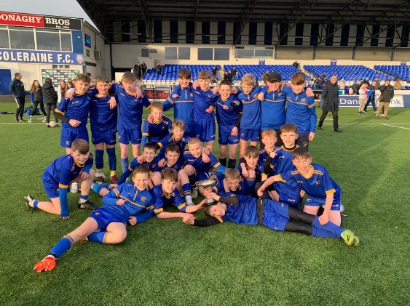
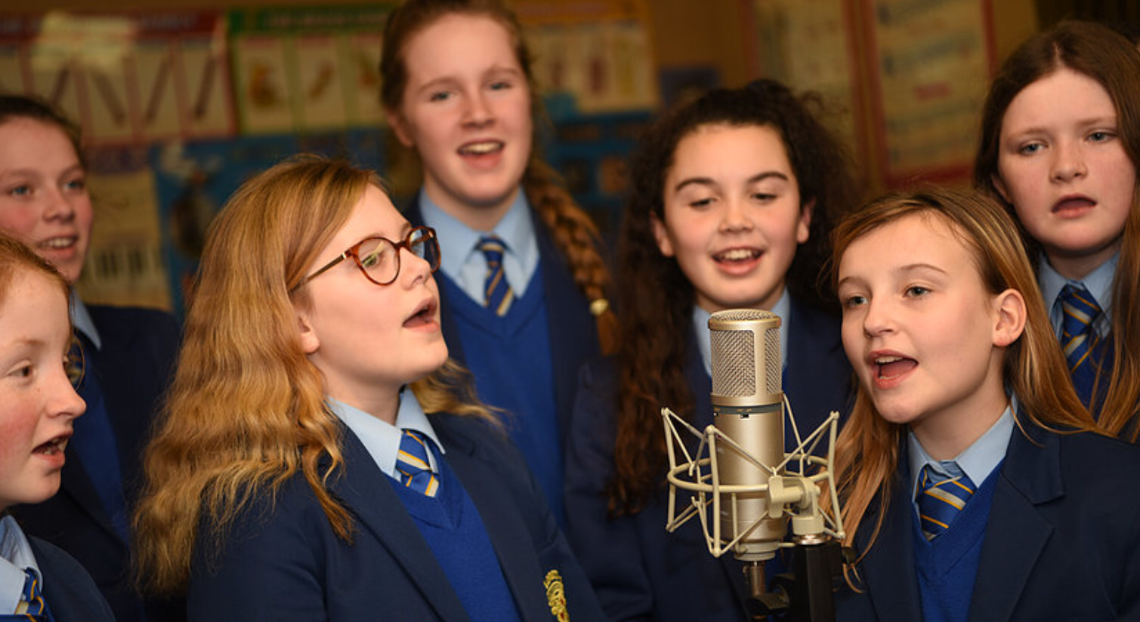
Extra curricular
Gaelic Games Promotion Officer –Cahir Higgins
Choir
Orchestra
Eco-club
Art Club
Netball
Cross country
Soccer
Drama club
Basketball
Music
Notes:
The transition to secondary school is a period of significant loss of children's involvement in sports. Around one in five children stop participating in sports, including GAA, between primary and secondary school. The situation is particularly stark for girls, with about half dropping out by age 13, making them three times more likely to quit than boy.
Clubs & Extracurricular Activities: Joining a club is one of the best ways to meet like-minded peers. Whether it’s sports, music, drama, or any other cubs we have running. These activities give pupils a chance to connect outside the classroom and build friendships based on shared interests. It also allows pupils to add to their skills and qualities, which in the end are vital for their move to University or further study after school.

Slide 37
Finally …
We have receptive pupils
Attendance is vital: miss school, miss out
Manners & Respect is core
Uniform
Develop good study habits
Become part of our Loreto community!

Slide 38
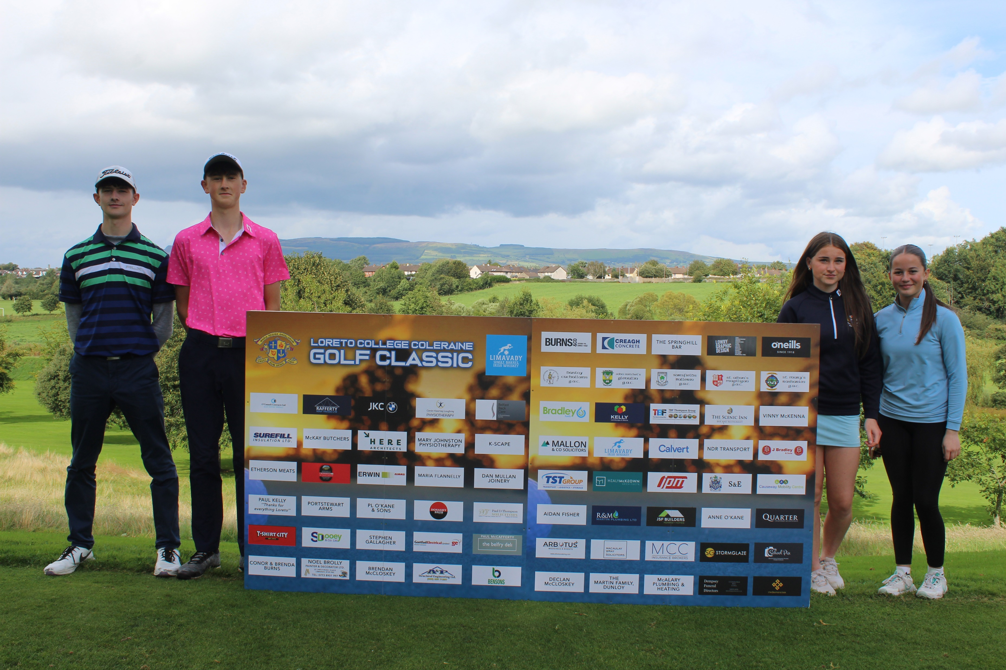
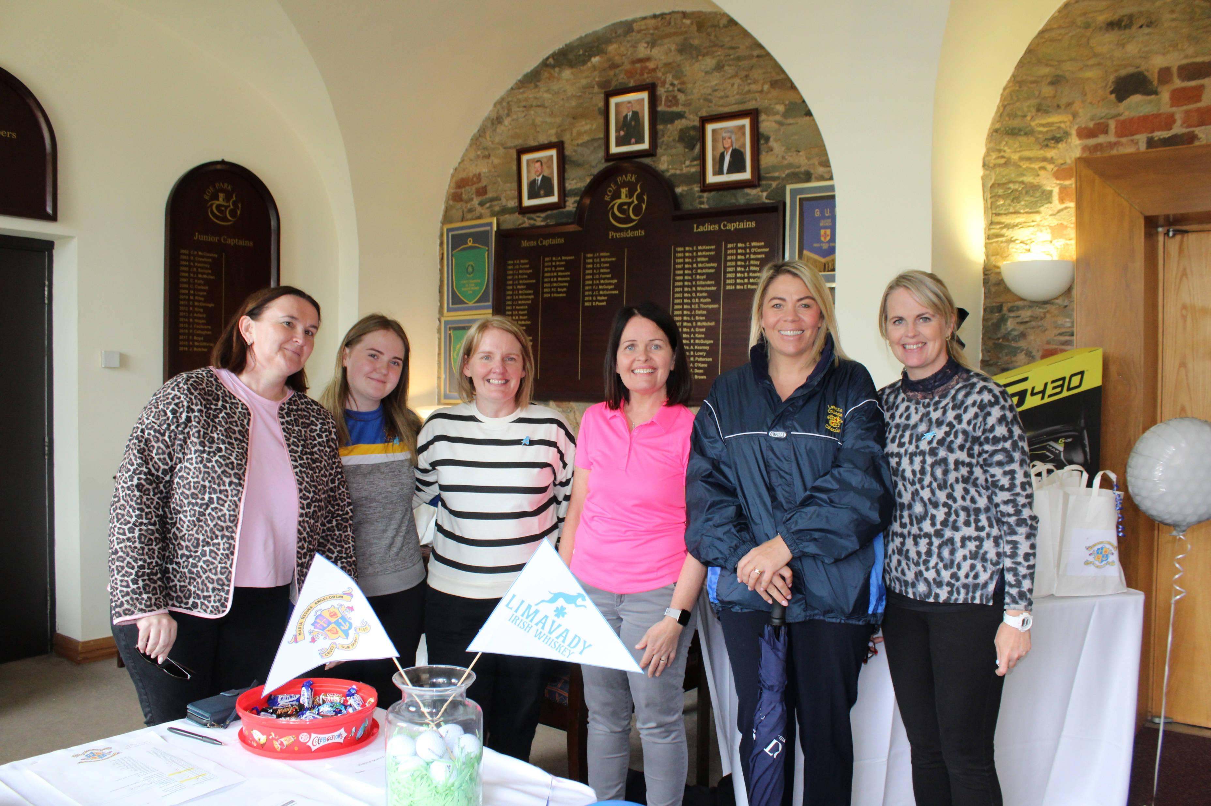
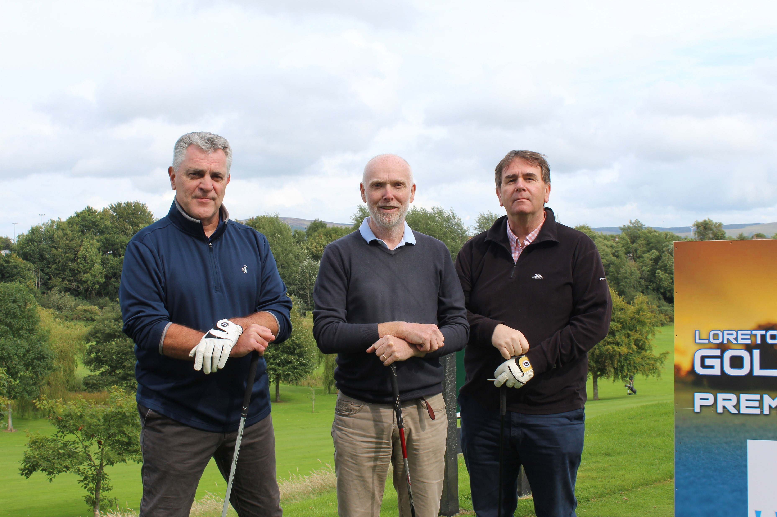
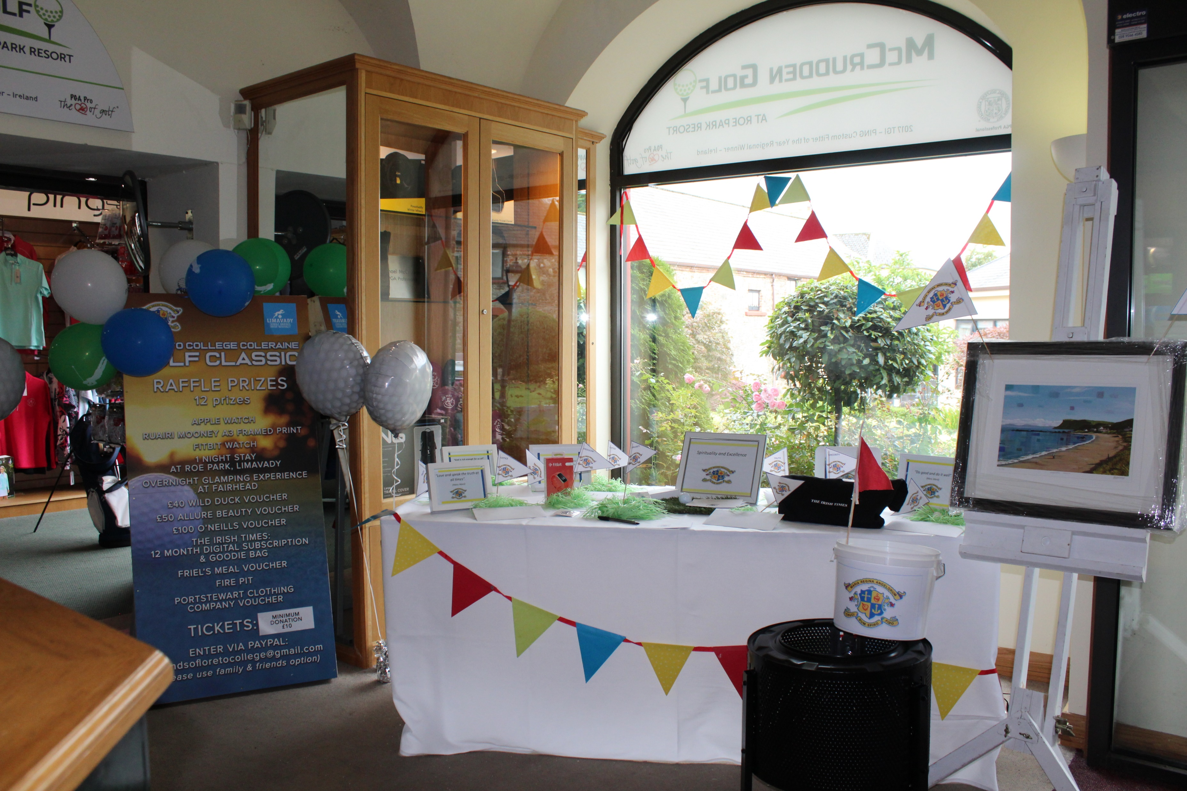

Friends of Loreto & Events

Slide 39
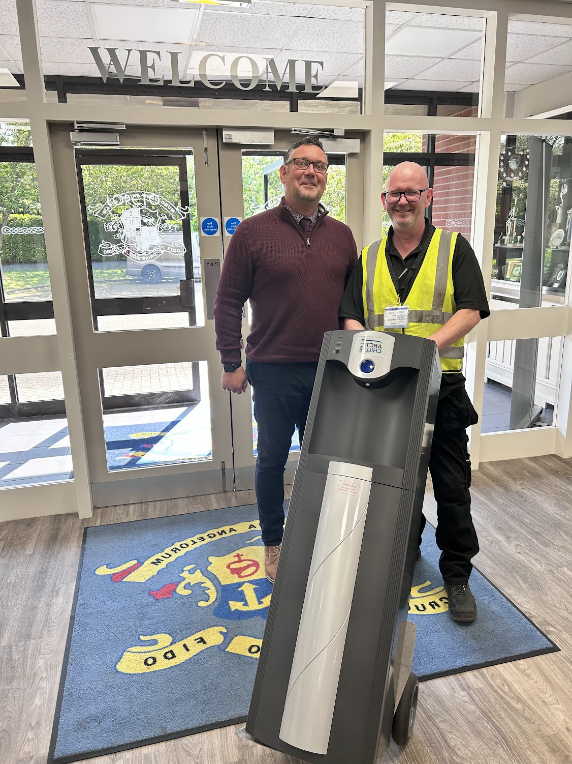
New Hydration Stations

Slide 40
Thank you for your support.
Evaluation Form
Form Teachers – School Canteen

Slide 41

Please scan and complete our evaluation form

