Slide 1
EDUCATION RESTART March 2021
‘Keep Our Loreto Community Safe’

Slide 2
Let’s start with you and your well-being…

Slide 3
Concerns
Exams / Assessments
'Catch up'
Keeping safe
Too many people
Nervous about seeing everyone
Wearing a mask all day

Slide 4
Routine
Routines promote healthy habits.
For people with busy schedules, daily plans can promote healthy lifestyle habits. Simple changes like packing your bag the evening before school or packing a more balanced diet will help you feel more organised.
Set aside time to focus on your physical health.
Reduce time on social media.

Slide 5
Healthy Eating
Eat regular meals
Do not skip breakfast
Do not get dehydrated
Eat a balanced diet and remember to:
a) include high fibre, starchy carbohydrates
b) Eat lots of fruit and veg
c) Eat more fish
d) Cut down on saturated fat and sugar
e) Eat less salt
Get active and maintain a healthy weight

Slide 6
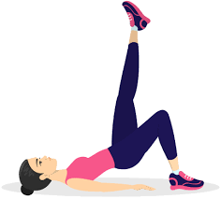
Exercise
Physical activity has a huge potential to enhance our wellbeing.
Even a short burst of 10 minutes' brisk walking' increases our mental alertness, energy and positive mood.
Participation in regular physical activity can increase our self-esteem and can reduce stress and anxiety.

Slide 7
Sleep
It is important to get a good night’s sleep.
Few people manage to stick to strict bedtime routines.
Sleep at regular times - This programmes the brain and internal body clock to get used to a set routine.
Most adults need between 6 and 9 hours of sleep every night. By working out what time you need to wake up, you can set a regular bedtime schedule.
It is also important to try and wake up at the same time every day.

Slide 8
Winding Down
Winding down is a critical stage in preparing for bed. There are lots of ways to relax:
a warm bath (not hot)
writing 'to do' lists for the next day
relaxation exercises, such as light yoga stretches, help to relax the muscles
listening to relaxing music
reading a book or listening to the radio relaxes the mind by distracting it
using apps such as ‘CALM’
avoid using smartphones, tablets or other electronic devices for an hour or so before you go to bed as the light from the screen on these devices may have a negative effect on your sleep pattern

Slide 9
Anxiety
Anxiety is a feeling of unease, such as worry or fear, that can be mild or severe.
Everyone has feelings of anxiety at some point in their life. For example, you may feel worried and anxious about sitting an exam, having a medical test or job interview.
During times like these, feeling anxious can be perfectly normal.
But some people find it hard to control their worries. Their feelings of anxiety are more constant and can often affect their daily lives.

Slide 10
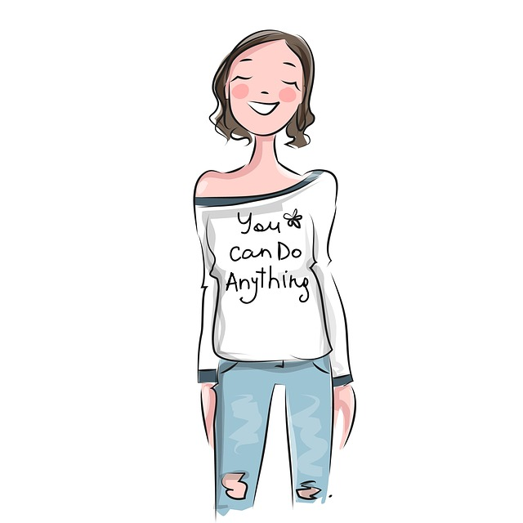
Coping Strategies
Take a time-out
Limit caffeine
Take deep breaths
Count to 10 slowly
Do your best and accept that this is ok
Accept that you cannot control everything
Welcome humour and have a laugh!
Maintain a positive attitude
Learn what triggers your anxiety
Talk to someone

Slide 11
Remember
You cannot control everything...
But, here are 10 things that you can control....

Slide 12
Sources of Support
Family
Friends
School Staff
Child Line
Familyworks Counselling
Useful Apps (I.e. CALM)
Text A Nurse service

Slide 13
Take 5

Slide 14
We look forward to seeing you all on Monday 12th April! The following slides are to familiarize you with the routines, we want you to keep when you are back in school

Slide 15
Entrance into school grounds
Students must come directly into school when they have been left off in the mornings.
Year groups ,must enter the school grounds via the following gates, and go directly to first class for Monday week 2:
Entry Gatestps://www.bbc.co.uk/bitesize/guides/zbj48mn/revision/8 | Year Groups
Top gate leading to west door | Years 10 and 12
Middle gate leading to entrance beside VP offices | Years 8, 9 and 11
Gate Lodge entry of Convent Car Park, leading to St. Mary’s door at convent | Years 13 & 14

Slide 16
Guidance
Social distancing is encouraged, as shown in signs throughout school.
Social distancing falls under two broad headings –
increasing separation; decreasing interaction (bubbles).
As far as possible, respect to 2 metre social distancing remains in place for adults and between adults and pupils.
Try to keep apart from each other, with at least a 1 metre distance.
Passing each other in corridors is considered low risk.
Teachers will remain based in their own classroom.

Slide 17
PPE Public Health Guidance
Staff will wear masks / visors
Students are advised that the wearing of masks is mandatory on public transport, and they are recommended for enclosed areas – e.g. toilets, or walking on corridors between classes. Students choose to wear their masks in class.
Pupils should have navy or black masks for school use.
Canteen staff will also wear PPE.
Visitors to the school must wear masks; entry to school –
must be on appointment only!

Slide 18
Government Guidelines on face coverings
• Face coverings should not be shared with others.
• Before putting on or removing the face covering, hands should be cleaned by washing with soap and water or hand sanitiser. Students are advised to carry their own sanitizer. There are sanitizing stations across the school also.
• Make sure the face covering is the right size to cover the nose, mouth and chin.
• When temporarily storing a face covering (e.g. during classes), it should be placed in a washable, sealed bag or container. Avoid placing it on surfaces, due to the possibility of contamination.
• Re-usable face coverings should be washed after each day of use in school at 60 degrees centigrade or in boiling water.
•Disposable face coverings must be disposed of safely and hygienically.

Slide 19
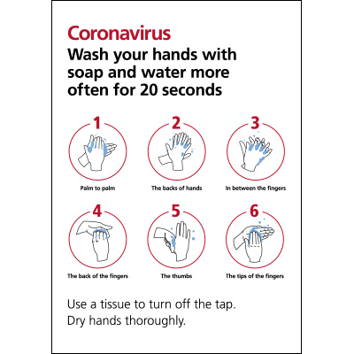
Sanitising Stations
Students should sanitise as they enter school and be advised to wash their hands with soap thoroughly at least four times throughout the day.
Sanitising stations are clearly marked around the school.
Students should carry their own sanitizer for personal use during the day.
Soap will be refilled in toilets – on-going.
Toilets are limited to two students going in at a given time.

Slide 21
‘Bubbles’
Students should not be mixing with other year groups, to reduce risk of virus transmission.
Years 13 and 14 students are allocated seats in the following areas for study, break and lunch.
Year 13 – Library and Main Study
Year 14 – Senior Study and Assembly Hall
Ideally, we encourage all students to go outside, into the fresh air at break-time or lunch-time, once you have had your snacks / lunch (weather permitting).
Students CANNOT stand around on corridors.
Locker areas are out of bounds.

Slide 22
Year Group Areas – Break-Time
Year Group | AREA (Students can go to the outside area listed – weather permitting; on cold / wet days – sheltered space is identified.)
Year 8 | Form rooms; VP Square, Convent Lawn
9A, 9B, 9C, 9E, 9F *9G, 9D | Form rooms; Convent Lawn at break Time Must go to sheltered area outside canteen or the convent lawn at break-time; not their form room
Year 10 *10A & 10E | Form rooms, Hockey pitch upper end. Hockey pitch upper end, areas outside canteen at break-time; not their form room
Year 11 | Sport’s Hall; Hockey pitch
Year 12 | Sport’s Hall; Hockey pitch Tech end
Year 13 | Library or Main Study
Year 14 | Assembly Hall or Senior Study

Slide 23
Lunch - recreational areas
Only year 13 have access to the Main Study.
Canteen is open and is sectioned off. Year groups are allocated a section to sit at.
Please remember to tidy up after yourselves at break and lunch. It is everyone’s duty to keep the school clean and hygienic! Make sure all litter is put in the bins provided.
Take care of the school grounds!
Those who take packed lunch must go to their allocated are in the Sport’s Hall
Period 6 | Sports Hall | Years 9 and 11
Period 7 | Sports Hall | Years 8, 10 and 12

Slide 24
One way System
You will remember our on-way system. It is important everyone adheres to the one-way system. Students must stay on the left and keep in line as far as possible, with a 1 metre distance from each other.
A yellow line going across half of a corridor means ‘give way!’ A full yellow line across a corridor is ‘no entry’.
We want to set really high standards from the outset about movement in the corridors.
Markings are down across floors to show directions.
Rules cannot be broken!
Please note – the doors beside the canteen, beside Mrs Sharkey’s music room, and leading out from Art to Technology - are EXIT only doors. No-one should be trying to come in to the school via those doors.

Slide 25
Classrooms
All rooms are now sectioned off, to give at least 2metres distance between staff and students.
Rooms should be well ventilated; door open if possible (teacher should open / close door / wipes will be provided).
Sanitizers have been fitted in each classroom, mainly for teacher use. Labs have washing facilities and soaps were left at sinks in each room.
Students should bring their own sanitizer; form teachers will check this!
Seats will face the front of the room.
Teachers will have a seating plan, so you will have a designated seat in each classroom. You must only sit, in that seat.
There should be a clear passage, for students to enter / exit classrooms and get to their allocated seat quickly.
Tissues, anti-bacterial wipes, cleaning spray and paper towels are in each classroom to use.
Form teachers will nominate a new class prefect each month; part of their responsibility will be to wipe over desks (wearing gloves) once classes leave.

Slide 26
In Class...
Students should not be sharing stationery or textbooks in classes.
If work is being collected in, staff should have an allocated shelf area for students to leave it / wear gloves.
Students are advised that there will be a gap until work is marked; at least 72 hours to correct work. Otherwise, teachers will instruct to have it sent on-line.
Elected class prefects should help to sanitise desks after class. Gloves are in each classroom.
Please make sure wipes are used to wipe over key-boards in computer rooms after use.
Students are reminded that they should be going straight home after school. You are not allowed to go down-town.
We will not be running extra-curricular activities; this will be reviewed on-going.

Slide 27
General Advice...
Pupil COVID contracts were sent to parents insisting that our students adhere strictly to all safety guidelines.
Behaviour policy / sanctions - updated to cover COVID related incidents which result in any possible risk to others.
In form class...
There is a clear Class Code; include -
Catch It! Bin It! Kill It!
Encourage good hygiene.
Discourage touching eyes, face, nose and mouth.
Cough into elbow, if you do not have a tissue.
Tissues must be disposed of in bins after use.

Slide 28
Government Guidelines
Any pupil displaying symptoms must not attend school.
If you have symptoms of coronavirus infection (COVID-19), however mild, do not leave your home for 10 days from when your symptoms started. This action will help protect others in your community while you are infectious.
If you live with others and you or one of them have symptoms of coronavirus, then all other household members must stay at home and not leave the house for 10 days. The 10-day period starts from the day when the first person in the house became ill.
Contingency plans are in place for students who have to self-isolate, so remote learning can still operate.
More information is available on the gov.uk website

Slide 29
Finally…
We look forward to you all returning!
You will get the chance to meet up with friends again to catch up.
If you are worried or unsure about anything, speak to any member of staff.

